Slide 1
Faculty of Mathematics and Physics
Charles University
Game User Experience
Lecture 12

Slide 2

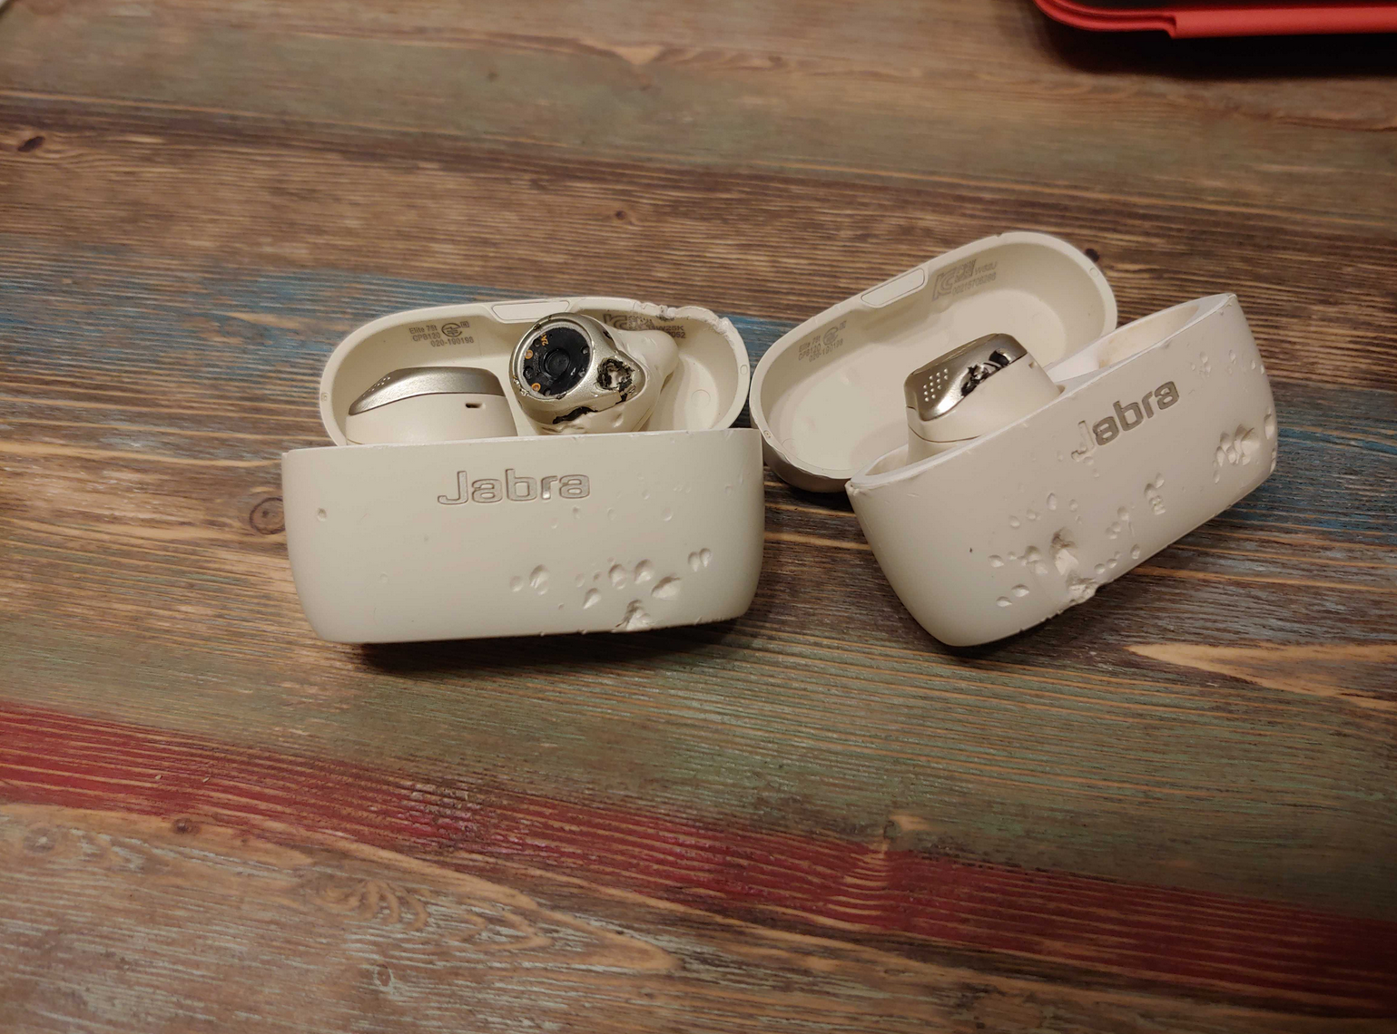
Practical info

Slide 3
Practical info
Last lecture
All the assignments rdy
Summaries in your emails
Discuss ideas via Discord

Slide 4
Shared Document
Let‘s go to the g-doc https://docs.google.com/spreadsheets/d/1S224KOCIWKzA_WloW1wx3kx8IBXlc33VQ1ihAeZIDoY/edit?usp=sharing
(Link in the Discord)

Slide 5
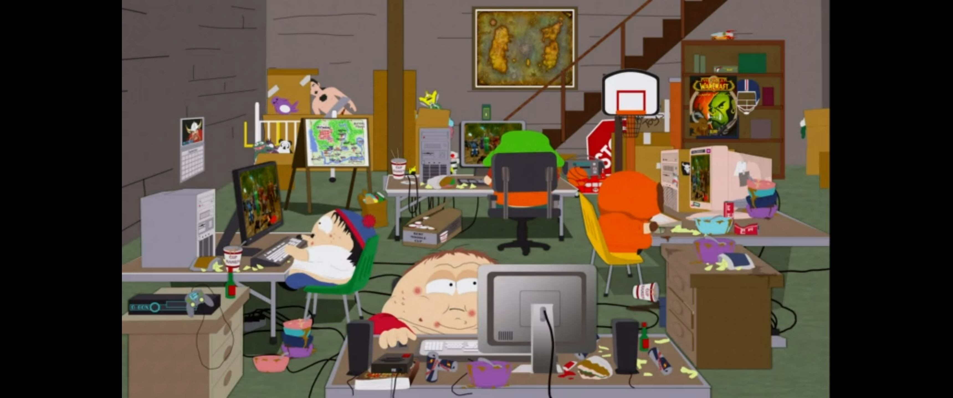
Physical health
Make Love, Not Warcraft (South Park S20E08, southparkstudios.com; 2006)

Slide 6
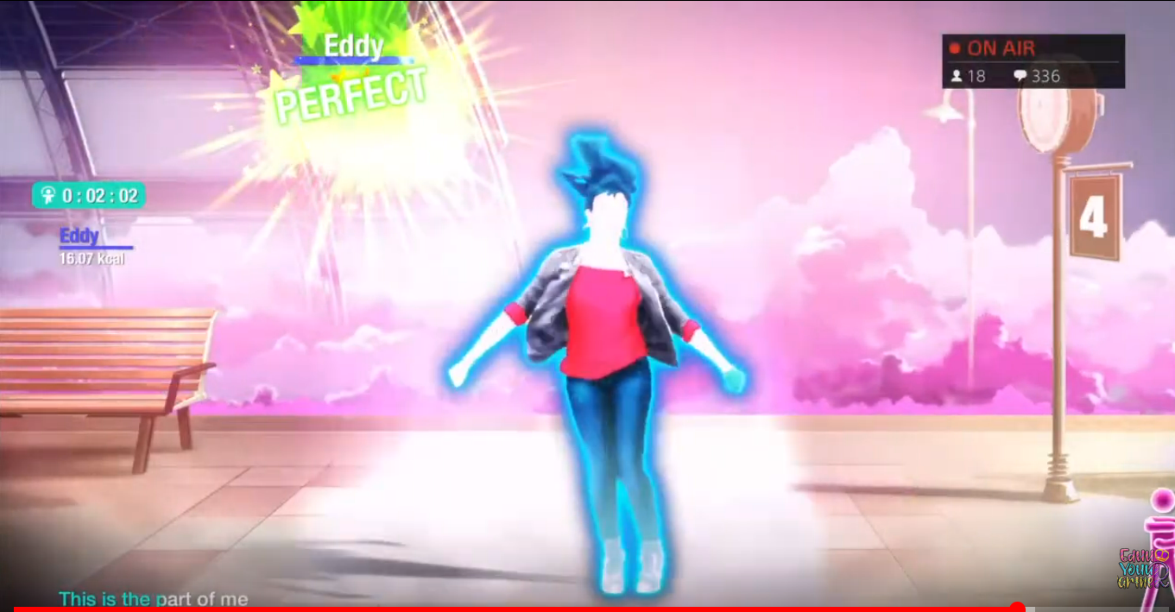
Physical health - Exergames
Just Dance 2022 (Ubisoft, 2021)

Slide 7
Physical health - Exergames
Graves L, Stratton G, Ridgers ND, Cable NT. Energy expenditure in adolescents playing new generation computer games. Brit J Sport Med. 2008; 42: 592–594.

Slide 8
Physical health - Obesity
Morgenstern M, Sargent JD, Hanewinkel R. Relation between socioeconomic status and body mass index: Evidence of an indirect path via television use. Arch Pediatr Adolesc Med. 2009; 163: 731–738.
Marshall SJ, Biddle SJH, Gorely T, et al. Relationships between media use, body fatness and physical activity in children and youth: a meta-analysis. Int J Obesity. 2004; 28: 1238–1246.
Williams D, Yee N, Caplan SE. Who plays, how much, and why? Debunking the
stereotypical gamer profile. J Compu-Mediat Comm. 2008: 13(4); 993–1018.

Slide 9

Physical health - Food
KFC ‘Snack in the Face’ (2013)

Slide 10
Physical health - Food
Harris JL, Speers SE, Schwartz MB, Brownell KD. US food company branded advergames on the Internet: Children’s exposure and effects on snack consumption. J Child Media. 2012; 6: 51–68.

Slide 11
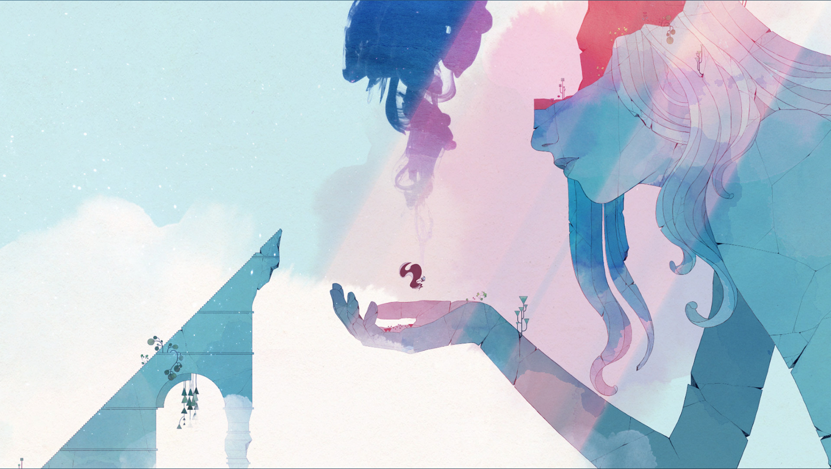
Mental health
Gris (Nomado Studio, 2018)

Slide 12
Child and youth development
Managing feelings
Trying new identities
Leadership and Teamwork
Competition and Initiative
Curiosity, Self-expression and Testing limits
Practicing setting goals and coping with frustration
(Kowert & Quandt, 2016)

Slide 13

ADHD
EndeavorRx (Akili Interactive Labs. 2021)

Slide 14
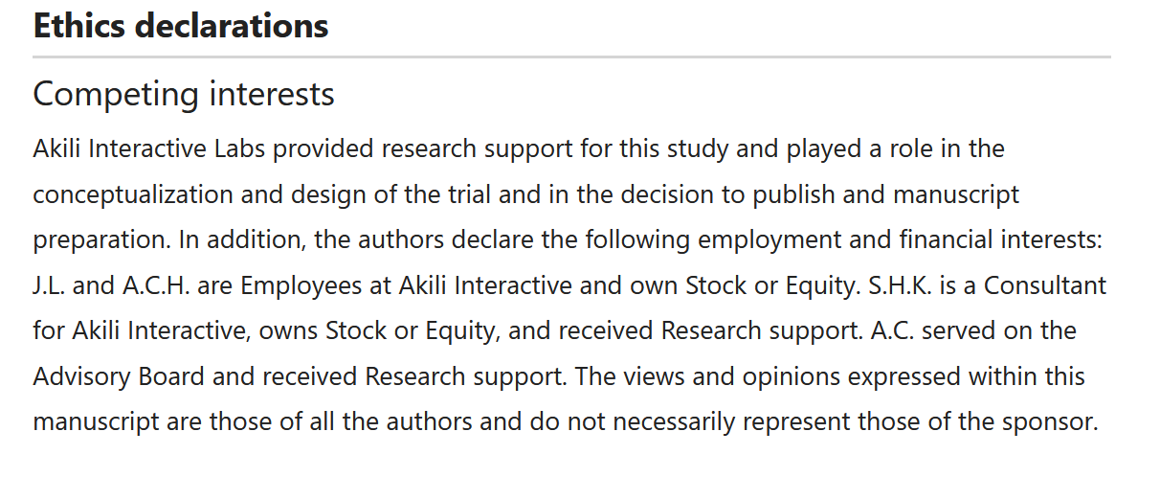
ADHD
Kollins, Scott & Childress, Ann & Heusser, Andrew & Lutz, Jacqueline. (2021). Effectiveness of a digital therapeutic as adjunct to treatment with medication in pediatric ADHD. npj Digital Medicine. 4.

Slide 15
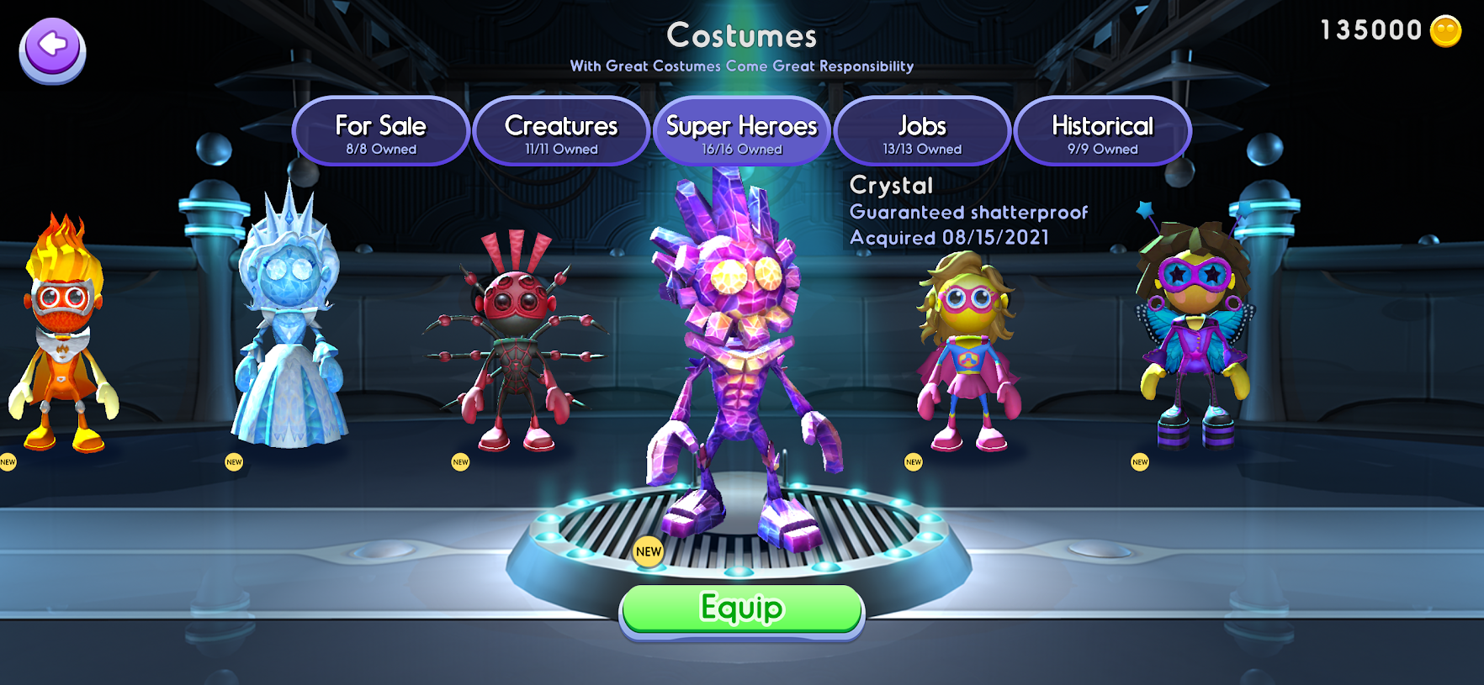
ADHD
EndeavorRx (Akili Interactive Labs. 2021)

Slide 16
Depression
Do you know any games dealing with this topic?
SHARED DOC https://docs.google.com/spreadsheets/d/1S224KOCIWKzA_WloW1wx3kx8IBXlc33VQ1ihAeZIDoY/edit?usp=sharing

Slide 17
Depression
Tortolero SR, Peskin MF, Baumler ER, et al. Daily violent video game playing and depression in preadolescent youth. Cyberpsychol Behav Soc Netw. 2014; 17: 609–615.
Brunborg GS, Mentzoni RA, Froyland LR. Is video gaming, or video game addiction, associated with depression, academic achievement, heavy episodic drinking, or conduct problems? J Behav Addict. 2014; 3: 27–32.
Ferguson CJ, Olson CK. Friends, fun, frustration and fantasy: Child motivations for video game play. Motiv Emotion. 2013; 37: 154–164. 19.
Przybylski AK. Electronic gaming and psychosocial adjustment. Pediatrics. 2014; 134: e716–e722.

Slide 18
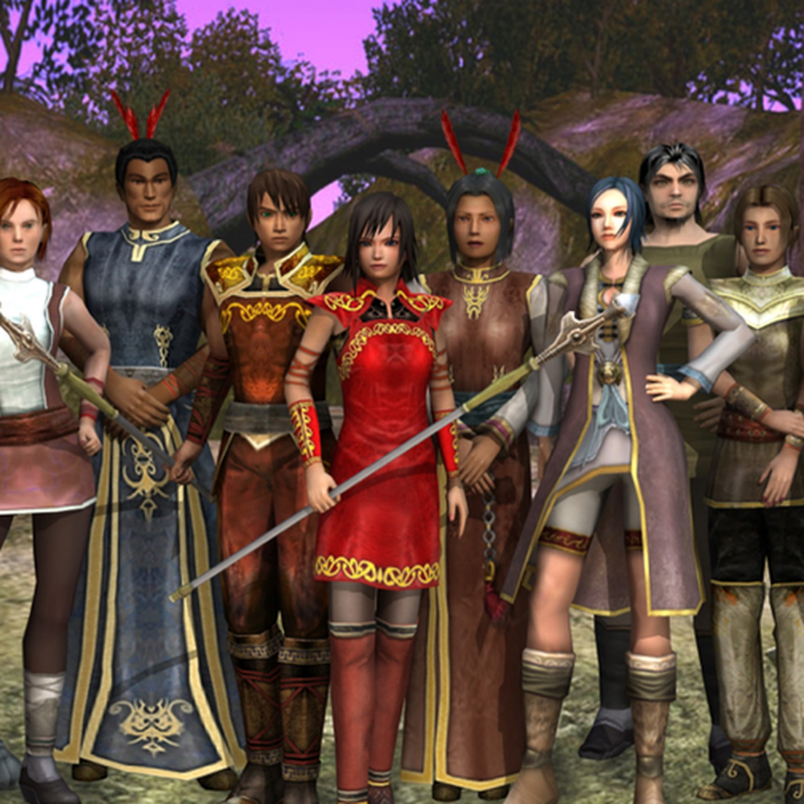
Depression
EndeavorRx (Akili Interactive Labs. 2021)

Slide 19
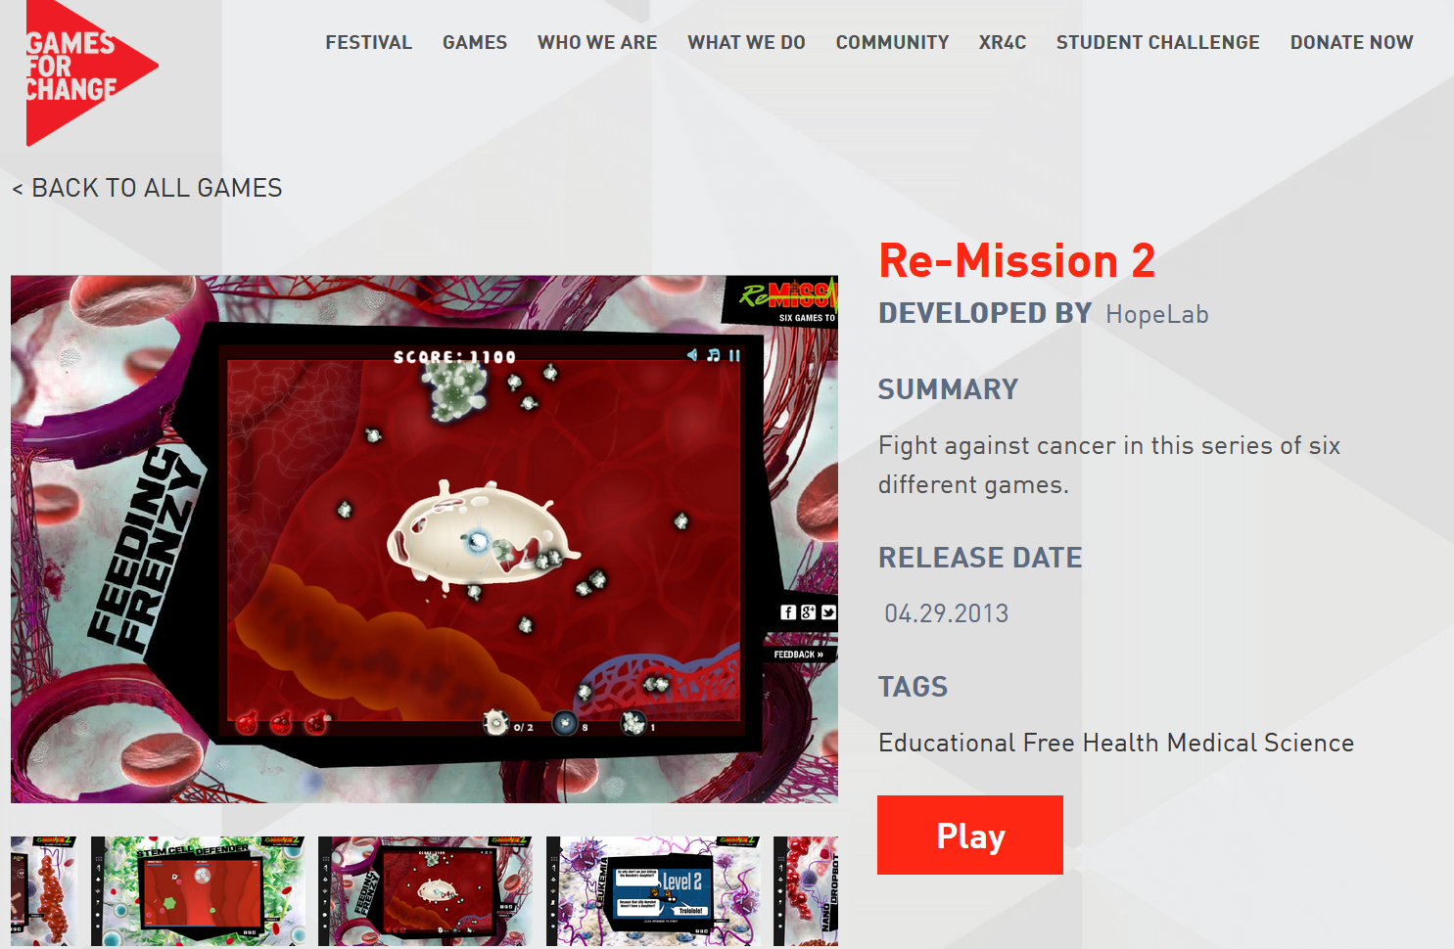
Does playing violent games make players more aggressive?
Hundreds of studies on the topic (shared doc)
Gamesforchange.org
Notes:
It is a developers account – I am collecting data only from a certain population – probably gamers, somehow focused on some types of games
Response bias - where there’s something about how the actual survey questionnaire is constructed that encourages a certain type of answer, leading to measurement error.

Slide 20
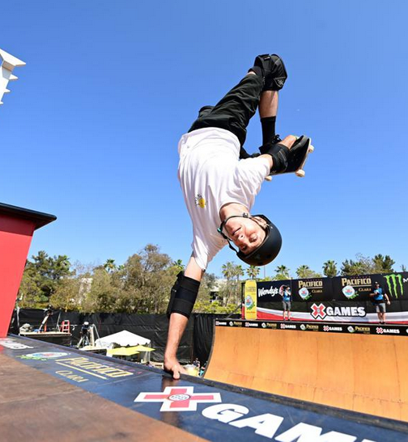

Risk Behaviours
Tony Hawk‚ (Forbes.com)
Tony Hawk's™ Pro Skater™ 1 + 2 (Vicarious Visions, Neversoft. 2020)

Slide 21
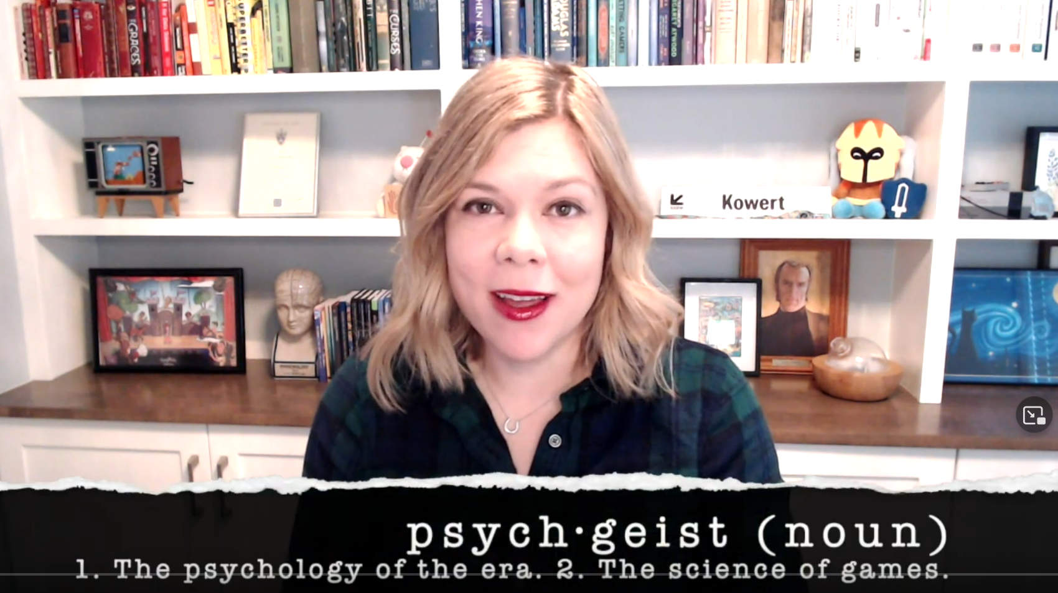
Gaming disorder
Rachel Kowert - State of the Research on Gaming Disorder
https://www.youtube.com/watch?v=7-KcrWjkPa8&ab_channel=Psychgeist
Notes:
It is a developers account – I am collecting data only from a certain population – probably gamers, somehow focused on some types of games
Response bias - where there’s something about how the actual survey questionnaire is constructed that encourages a certain type of answer, leading to measurement error.

Slide 22
Summary
General Effects of Video Games on Obesity vs Exergames
Advergames and Their Effects
Child and Youth Development & Games
Video Games and Depression & ADHD
Video Games and Risk Behaviours
Gaming Disorder and Limits of Our Knowledge

Slide 23
Faculty of Mathematics and Physics
Charles University
Last lecture is over
Stay in touch on Discord

